Slide 1
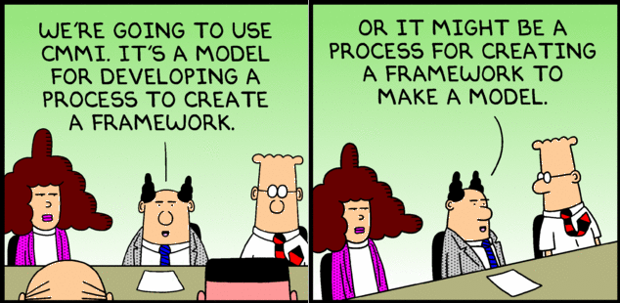
System Diagrams
A Visual representation of the system

Slide 2
Frank Brooks
Today I am more convinced than ever. Conceptual integrity is central to product quality. Having a system architect is the most important step towards conceptual integrity.
The Mythical Man Month

Slide 3
Model
  A model is a description from which detail has been removed in a systematic manner and for a particular purpose
  A simplification of reality intended to promote understanding
  Models are the most important engineering tool, they allow us to understand and analyze large and complex problems
https://www.cl.cam.ac.uk/teaching/1112/SWDesign/softwaredesign01.pdf
Notes:
A question to ask yourself when you’re starting to think about developing a System Model – What am I trying to communicate about this system?

Slide 4
Robert Spinrad
A good solution somehow looks nice
1991

Slide 5
System Diagram
  Abstract Description of the system whose requirements are being modeled
Components of a System Diagram:
  Boundaries of the overall system
  Inputs to and outputs from the system
  Subsystems of the system
  Identification of the interfaces between the subsystems
  A System Diagram is a high-level model of the system.

Slide 6
Why Create a System Diagram?
  To help explain the proposed requirements to other system stakeholders.
  To discuss design proposals with engineers and to document the system for implementation.
  To show the organization and architecture of the system.

Slide 7
Type of System Diagrams
System Diagrams are variable in their view of the system
A system diagram can show
- Components
- Interactions
- Boundaries
- …
Choose the type of information you want to convey AND what questions you are trying to answer
  Big blocks
  APIs
  Physical assets
  Data or communications
  …
Then select HOW you will show it
Components & Interactions tend to be the most common

Slide 8
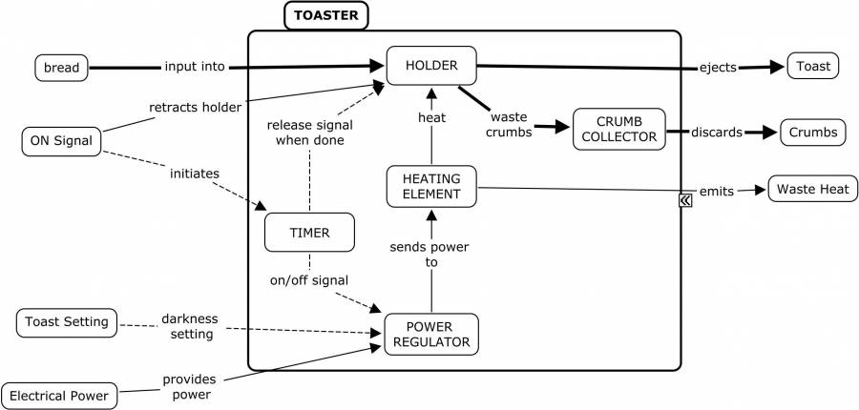
Toaster System Diagram:
Inputs
Outputs
System
Where’s the WIFI connection?
https://deseng.ryerson.ca/dokuwiki/_detail/design:toasterarchitecture.jpg?id=design%3Asystem_diagram

Slide 9
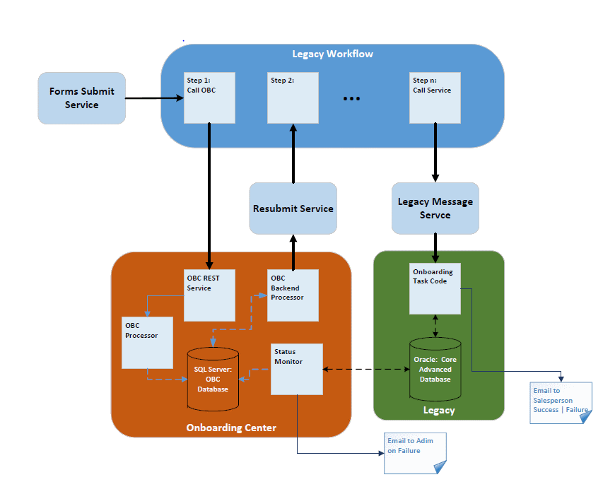
Onboarding System
Notes:
Early prototype of the system built to illustrate that a new service could be interposed in the legacy workflow and enrich the content flowing into the Legacy System (Green box).

Slide 10
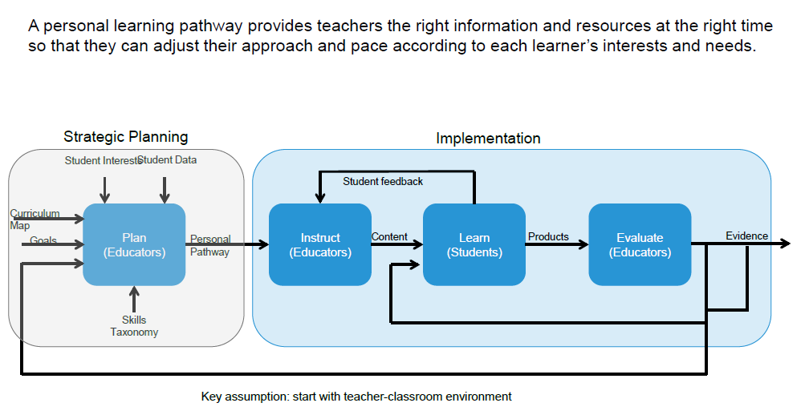
Personal Learning Pathways: Systems View
Notes:
A system designed at PARC for Personalized Learning. Used to discuss the system with school administrators, teachers and parents

Slide 11
Unit of study as a context for prototyping
Student Performance
Learn
(Students)
Feedback for instruction & planning
Student Profile
Instruct
(Teacher)
Practice
Plan
(Teacher)
Paths
Evaluate
(Teacher)
Evidence
Demo
Content, Curriculum map
Student Profile
Alerts
Goals and Interests
SIS
Unpack concepts
Sequence
Scaffold
Model
Assign
Score
Monitor
Adjust
Communicate
Collaborate
Teach interventions
Mastery
Growth
Portfolio
  Exemplar
  Parent/teacher
  APPR
  Issue tracking
Practice (assignments, check-ins, formative assess)
Demonstrate (summative, benchmark)
Collaborate (teachers, peers)
Reflect on student performance
Student Performance
Pre-assessment
ELA summary
Writing samples
Paths
Mastery visualization
Student grouping
Key messages
Providing teachers a dynamic, holistic view of each student facilitates personalization day-to-day.
Easy and timely access to the desired information is a key challenge.
Understanding what teachers do with this information guides future development.
11
Notes:
A more detailed view that layers in where various functionality exists in the system. The circled items are were the development team was initially focused.

Slide 12
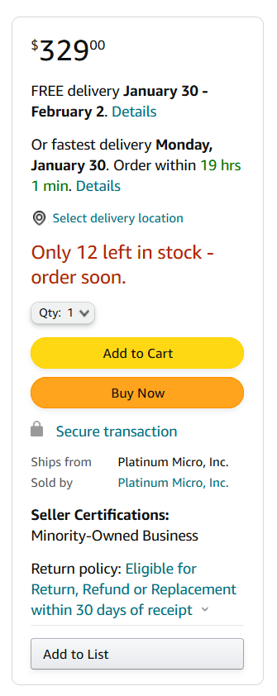
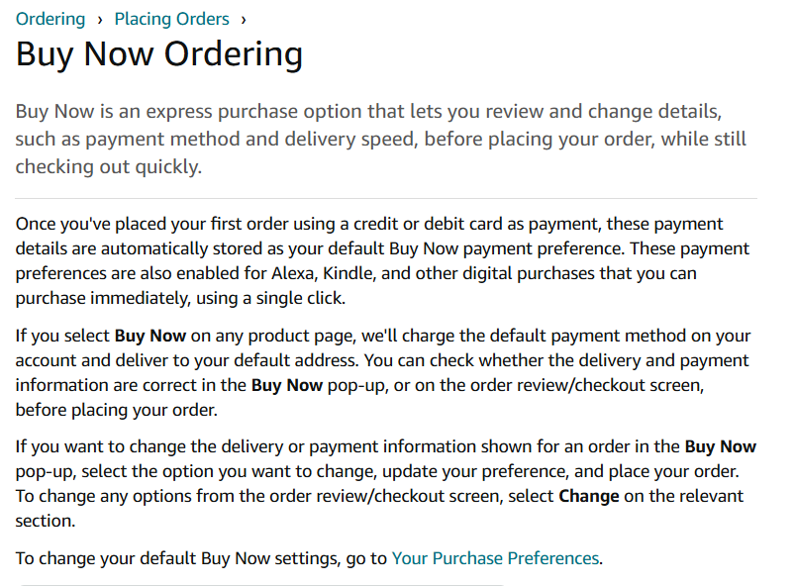
Amazon Buy Now
Components of a System Diagram:
Boundaries of the overall system
Inputs to and outputs from the system
Subsystems of the system
Identification of the interfaces between the subsystems
Notes:
How do we turn this description and picture into a system diagram?

